Slide 1
Results from a cluster-randomized trial to evaluate a microfinance and peer health leadership intervention to prevent HIV and intimate partner violence among social networks of Tanzanian men
Suzanne Maman¹*, Marta I. Mulawa², Peter Balvanz¹, H. Luz McNaughton Reyes¹, Mrema N. Kilonzo³, Thespina J. Yamanis⁴, Basant Singh⁵, and Lusajo J. Kajula³
¹ University of North Carolina at Chapel Hill
² Duke University Global health Institute
³Muhimbili University of Health and Allied Sciences
⁴Americ5an University School of International Service
⁵Medical University of South Carolina

Slide 2
Background
Women are disproportionately impacted HIV
High prevalence of intimate partner violence (IPV) has devastating health implications for women
Strategies to engage men in HIV and IPV prevention is critical given their control over the terms and conditions of sexual partnerships
Risk reduction interventions designed to work with social networks likely to result in sustained behavior change

Slide 3
Formative research to identify social networks of young men and pilot IPV & HIV prevention
  Venue-based sampling method to identify places where young men socialize with their networks
  Social networks of men spend time in “camps”
  Camp members wanted business training and access to credit to support business enterprise
  Piloted an intervention that combined microfinance and peer health leadership

Slide 4
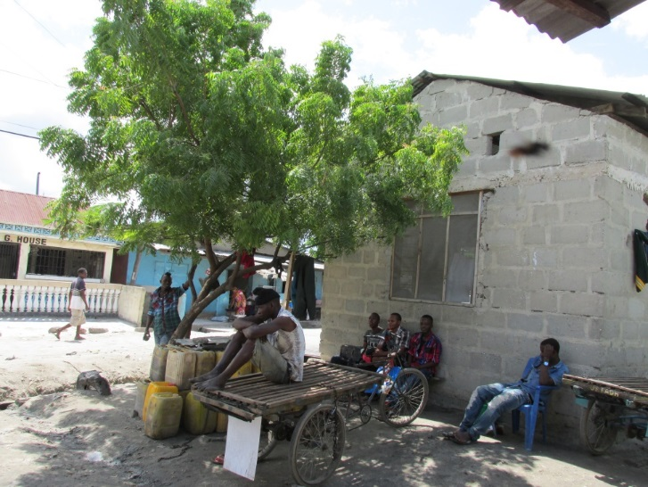
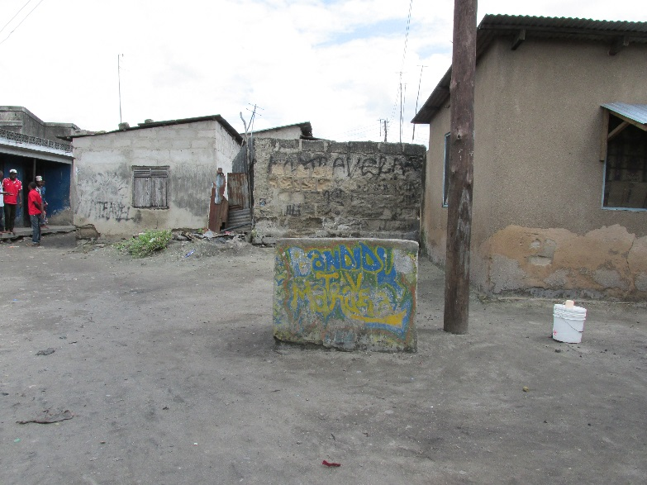
Camp-based social networks
Naturally occurring social networks
Networks socialize in fixed locations
Identified 70 camps in one ward
On average camps exist for 8 years
Average of 32 members, 85% male
Mean duration of membership 5.7 yrs.
Elected leadership (e.g. Chair, Secretary)

Slide 5
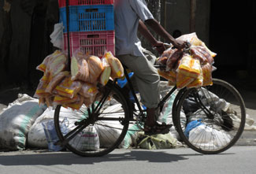
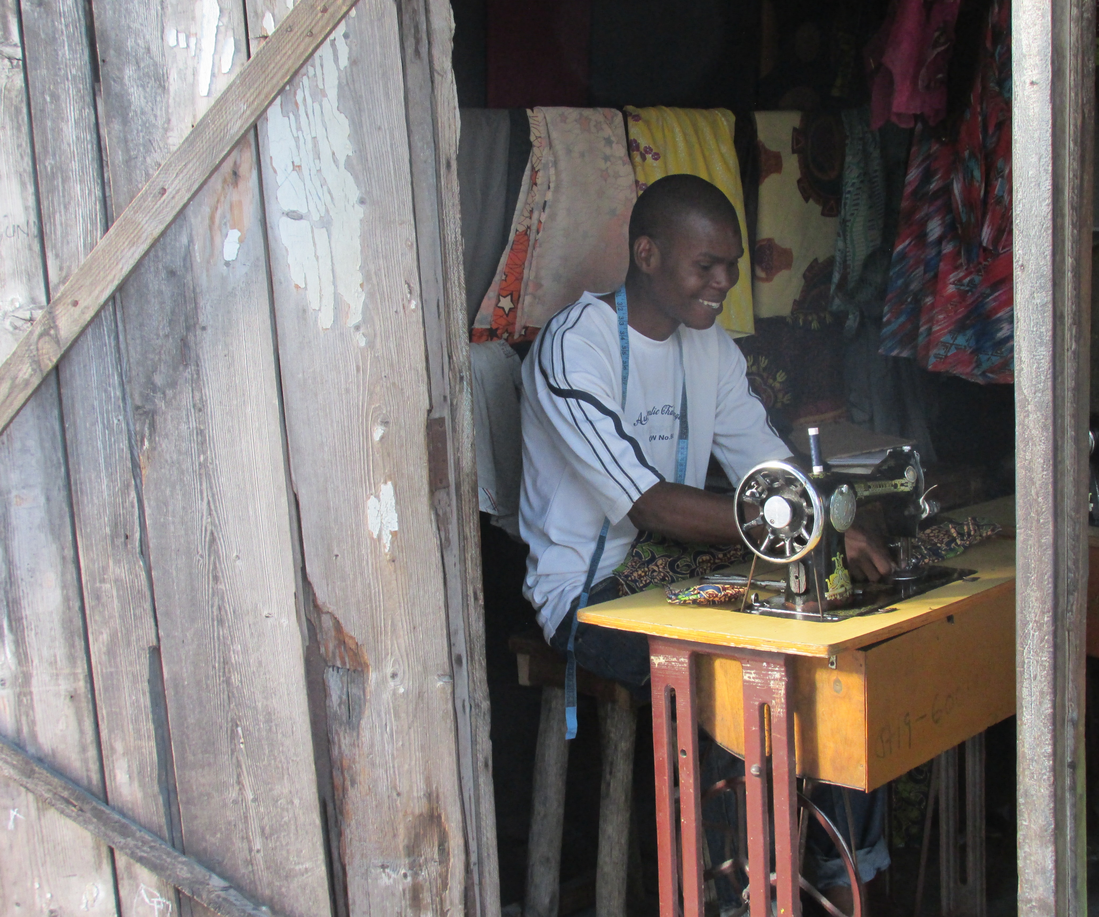
Vijana Vijiweni II (VVII)Aims
Cluster-randomized trial to evaluate microfinance and peer health leadership intervention.
Primary outcomes:
    Prevalence of STIs and past-year perpetration of physical and/or sexual IPV
Secondary outcomes:
      sexual risk behaviors and past-year HIV testing
  Hypothesized mediators:
    inequitable gender norms and hope

Slide 6
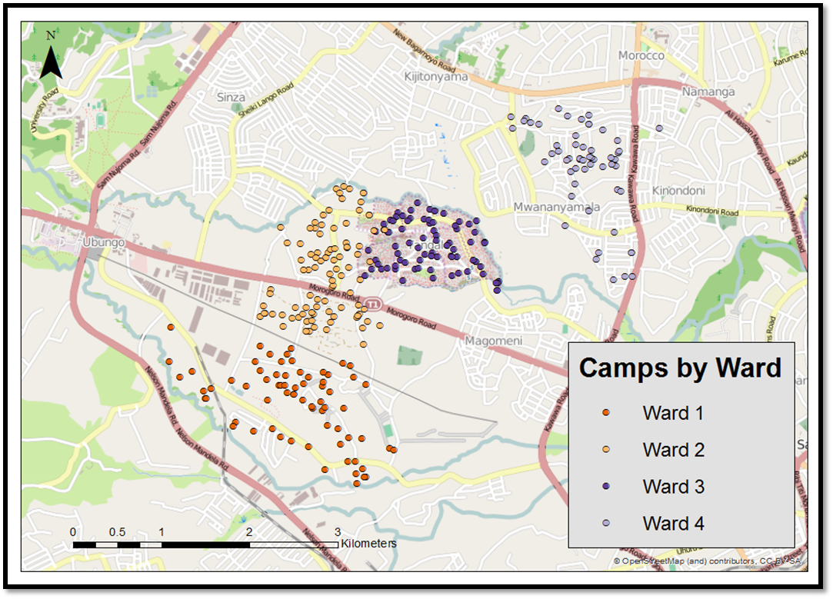
Identifying and selecting camps for trial implementation
205 eligible camps: exist for 1+ years, 20-80- members, safe
Clustered contiguous camps and selected clusters using probability proportionate to size procedure
Selected simple random sample of 60 camps within clusters

Slide 7
VVII Design
Enrolled 1249 men within 60 camps
2 years of intervention implementation
~ 80% retention at 30 months

Slide 8
VVII Intervention Description
Microfinance
Peer Health Leadership
524 men attended 5-day business training
Trainees who deposited $5 in savings, paid loan fees, formed a group, and had approved business plan eligible for loan
Loans started at $100 at 18% (6 months) or 27% (9 month) interest
Individuals who repaid eligible for 2nd loan of $185 and 3rd loan of $285
Weekly repayment sessions
Borrowers added $1.25 to savings weekly
Booster trainings held every 6 months
170 leaders nominated by peers in camps
Training focused on leadership, gender-based violence and power, HIV and condom myths, safe sexual practice, and effective messaging
Leaders used the skills in communication and influence to talk to peers
Maintained records of number and types of conversations
Booster sessions held every 6 months

Slide 9
Analytic Methods
Attrition analysis using logistic regression to test for differential lost to follow-up
Intention-to-treat approach and all models accounted for clustering of participants within the camps
To examine intervention effects on our primary and secondary outcomes, we used a modified Poisson regression approach for estimating relative risks (RRs)
Adjusted estimates controlled for baseline levels of outcomes, demographics and duration of camp membership.
Mixed linear models to examine intervention effects on proximal intervention targets while accounting for the clustering
Supplementary moderation analysis to examine whether treatment group effects were moderated by ward, age group, SES, and/or levels of camp cohesion.

Slide 10
Sample Characteristics at Baseline
 | Intervention, (n = 621) No. (%) or Mean ±SD | Control, (n = 628) No. (%) or Mean ±SD | p
Age in years
15-19 | 114 (18.4) | 119 (19.0) | .91
20-24 | 192 (30.9) | 182 (29.0)
25-29 | 162 (26.1) | 168 (26.8)
30+ | 153 (24.6) | 159 (25.3)
Education
Primary school or less | 356 (57.5) | 351 (56.1) | .36
Some secondary school | 65 (10.5) | 82 (13.1)
Secondary school completed or more | 198 (32.0) | 193 (30.8)
SES
Low | 207 (33.3) | 186 (29.7) | .37
Medium | 217 (34.9) | 229 (36.5)
High | 197 (31.7) | 212 (33.8)
Marital history
Never married | 478 (77.4) | 490 (78.0) | .77
Ever married | 140 (22.7) | 138 (22.0)
Ever had sex | 552 (88.9) | 561 (89.3) | .80
Number of sexual partners in last year
0 | 70 (12.7) | 78 (13.9) | .002
1 | 352 (63.8) | 397 (70.8)
2 | 77 (14.0) | 40 (7.1)
3+ | 53 (9.6) | 46 (8.2)
Current sexual partner | 378 (60.9) | 342 (54.5) | .02
Duration of camp membership (years) | 6.0 ±4.4 | 6.1 ±4.3 | .71
 | Intervention, (k = 30) Mean ±SD | Control, (k = 29) Mean ±SD | pª
Camp size (# of members in camp) | 26.0 ±9.6 | 26.9 ±11.5 | .76
Number of participants enrolled in trial | 20.7 ±8.7 | 21.7 ±9.3 | .69
30-month response rate^{b} | 80.9 ±13.1 | 83.4 ±15.1 | .50
Duration of existence (years) | 3.9 ±1.0 | 4.0 ±0.9 | .60
Intervention participants had more past-year sex partners and more likely to have current sex with partner at baseline. We controlled for this in our analysis

Slide 11
Primary and Secondary Outcomes
 |  |  |  | Intervention |  | Control |  | Adjusted Intervention Effects
 |  |  |  | No. of Partic. | Mean or Prop. | No. of Partic. | Mean or Prop. | RR or IRR | 95% CI | P value
STI
 |  | 30-month follow-up |  | 441 | 28.3 | 487 | 27.1 | 1.06 | (0.86, 1.31) | 0.57
IPV Perpetration (Physical/Sexual) - Past Year
Any IPV perpetration
 |  |  | Baseline | 621 | 16.4 | 628 | 15.9
 |  |  | 30-month follow-up | 496 | 23.2 | 533 | 19.9 | 1.14 | (0.91, 1.44) | 0.26
Onset of IPV perpetration
 |  |  | 30-month follow-up | 391 | 19.2 | 437 | 17.2 | 1.14 | (0.91, 1.44) | 0.26
Other HIV-Related Behaviors
Any unprotected sex acts
 |  |  | Baseline | 552 | 58.2 | 561 | 54.0
 |  |  | 30-month follow-up | 496 | 64.1 | 530 | 68.7 | 0.96 | (0.89, 1.05) | 0.41
Number of sexual partners
 |  |  | Baseline | 552 | 1.4 | 561 | 1.3
 |  |  | 30-month follow-up | 496 | 2.2 | 528 | 2.0 | 1.09 | (0.89, 1.34) | 0.41
Sexual Partner Concurrency (among sexually active)
 |  |  | Baseline | 552 | 19.0 | 561 | 15.7
 |  |  | 30-month follow-up | 496 | 39.7 | 530 | 34.5 | 1.14 | (0.96, 1.34) | 0.13
HIV Testing in last 12 months
 |  |  | Baseline | 621 | 45.3 | 627 | 46.3
 |  |  | 30-month follow-up | 496 | 52.6 | 533 | 47.3 | 1.13 | (1, 1.28) | 0.04*
No significant differences in STI prevalence or IPV perpetration
More HIV testing among men in intervention arm
*p < .05; ** p <.01; *** p < .001
Notes:
\

Slide 12
Hypothesized Mediators
 |  | Intervention |  | Control |  | Adjusted Intervention Effects
 |  | No. of Partic. | Mean or Prop. | No. of Partic. | Mean or Prop. | Effect | 95% CI | P value
Inequitable Gender Norm Attitudes
 | Baseline | 621 | 2.0 | 627 | 2.0
 | 30-month follow-up | 496 | 2.0 | 533 | 2.1 | -0.11 | (-0.2, 0.0) | 0.04*
Hope
 | Baseline | 621 | 3.1 | 628 | 3.1
 | 30-month follow-up | 496 | 3.2 | 533 | 3.2 | -0.0001 | (-0.1 0.1) | 1.00
Intervention reduced inequitable gender norm attitudes

Slide 13
Discussion
Successfully engaged and retained networks of men in multicomponent intervention
No significant effect on the primary outcomes or secondary STI risk behavior outcomes
Significant increase in HIV testing as well as a reduction in inequitable gender norm attitudes
First trial targeting social networks of young men in Africa to demonstrate effect on norms and behaviors
Working with social networks can effectively address low uptake of HIV testing among men
Implications for how to identify and engage men in urban African settings in prevention interventions

Slide 14
Acknowledgements
This research was sponsored by the U.S. National Institute of Mental Health(R21MH80577, R01MH098690)
Clinical Trials.gov: NCT01865383
Thanks to participants who gave generously of their time
Thanks to key study staff: G. Mwikoko, D. Kajuna, E. Nyka
Thanks to trainees: L. Hill, D. Conserve

